Slide 1
Problem Solving
Kat, Michael, Ryan

Slide 2
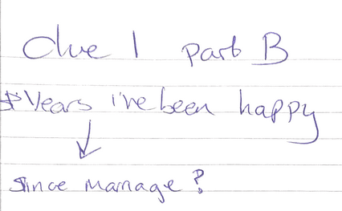

Task One – Finding and Interpreting the code
Initial State
Given and prior knowledge:
George Boole – Boolean which is either 1/0 meaning what non zero number must be related to Boolean logic in one way or another.
Clue One

Slide 3
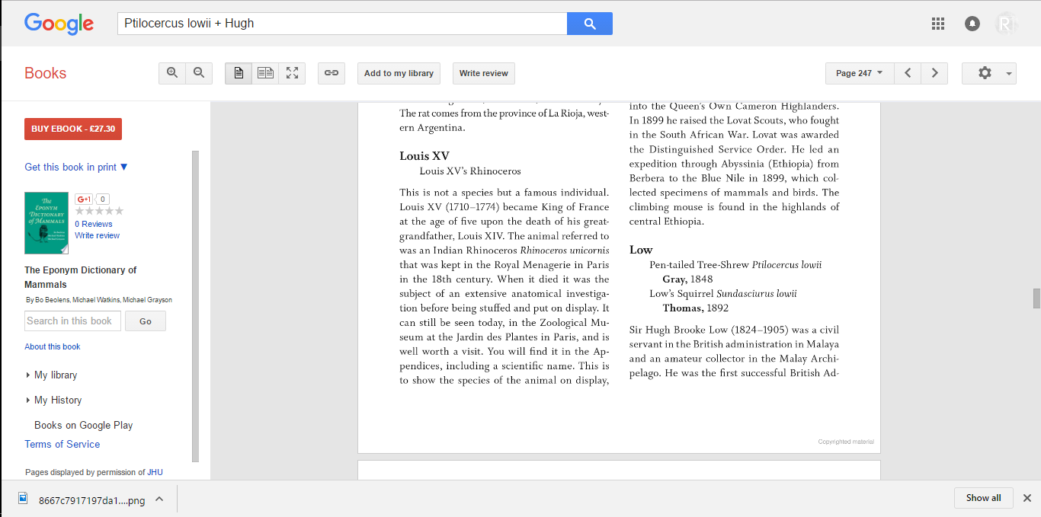
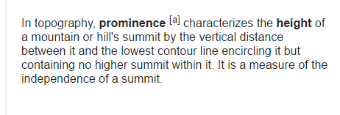
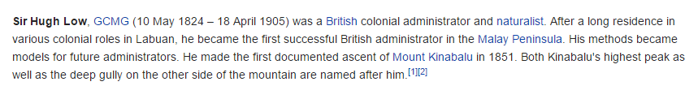
Task One – Finding and Interpreting the code
Clue One
Notes:
This was the question we as a group (when we were a 5) decided to leave till the end, one of the downsides of this is that we lost 2 members that would’ve been incredibly useful in solving this question. However we used our procedural knowledge once again to turn to google, which for part a was: For each integer n where n > 2; the equation an + bn = cn has no non-zero integer solutions a, b and c. This leads to Fermat's Last Theorem which states that no three positive integers a, b, and c satisfy the equation a^{n} + b^{n} = c^{n} for any integer value of n greater than two. Whilst 1 and 2 lead to infinite solutions. True. Part B would require derived knowledge from you, however we never received this, or never picked up that you had released this information. Since this was question was well defined we just had to find the link between a mountain and this shrew. Using the same method as for part A we found the link is Sir Hugh Low. But, we didn’t need this information. We could of made the solution more effective. But went the long way round as the height different between height and height is 0.
Confidence evaluation is either A1 B0 C0 or A1 B1 C0, which either gave us 15 or 35. Since we had no answer for B we left it as false.

Slide 4

Task One – Finding and Interpreting the code
Clue Two
Lodz is a place in Poland, and Drammen is a place in Norway.
Symmetrical reorganisation of zoo is ozo.
Örebro is a city in Sweden linked to Lodz and Drammen.
Truckfighters are a band from Sweden; one of the band member's name is Ozo.
First five albums of Truckfighters are Gravity X, Phi, Mania, Universe and V.
The key to BBEHEHLEZIEFIMINUMMICAWIISRIM is the five albums and ozo.
Decryption of BBEHEHLEZIEFIMINUMMICAWIISRIM is vkemwonhkbwtizanazenyjeenesug
Both have 29 characters – 29 + 29 = 58
Notes:
The initial stage consisted of finding out exactly what the terms Lodz and Drammen meant. As a rule of thumb; I knew to reorganize the word zoo into ozo. I could not fully understand the question because I had lack of information, due to the fact that the question mentioned a French word I have never heard of before. Through a google search I found out that the French word Vigenere was a term used to describe a method of encrypting alphabetic text.
The intermediate stage was figuring out the link between Lodz and Drammen and what musical connection they seem to have. Based on my research, a city in Sweden called Orebro is heavily linked to both cities due to the fact that the Wikipedia page of Orebro states that Lodz and Drammen are both sister cities of Orebro. In order to find a musical connection, I proceeded to continue research on Orebro and music until I stumbled upon a rock band called Truckfighters. This band stood out to me because one of the band member's name is ozo, so I instantly knew that this was the musical connection.
Now that I knew Truckfighters was the musical connection, the next step was to take five of the six major collections; in this case, this was the first five albums produced by the group.
The final stage of solving this problem was to combine the five albums and ozo, and then use that information as the key to the Vigenere cipher. I used an online decryption tool which was specifically designed to decrypt Vigenere with the help of a key. It would be extremely difficult to decrypt a Vigenere cipher without a key, because then you would have to go through the process of finding the length of the key and so forth. After I finally decrypted the cipher, I was disappointed to find out that the result was not what I was expecting at all. I was expecting to get a message or a number from the decryption that meant something. I saw that the end result had the same amount of letters as the Vigenere, however I knew the answer was supposed to be a two digit number so I used addition of both values to get the result of 58.

Slide 5
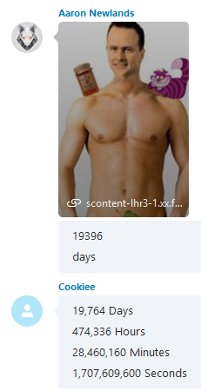



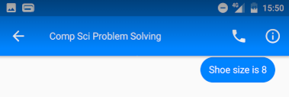
Task One – Finding and Interpreting the code
Clue Three
Take the locally significant rounded up next number in this sequence 122, 131.3, 150, and divide by 32.
178.2 / 32 = 5.56875
one day after the date that I will be giving you the answer to these clues = 25th or 27.
Notes:
This was a question we assumed was based around pattern recognition where we had to understand the pattern in the numbers and work out the next. We had the idea that for each number in the sequence was n+9 (9, 18, 27 etc.) and the decimal was .n+.1 each time (.3, .4, .5 etc) which gave us the value 28.2 plus 150. This clue worked on the concept of decomposition, where we weren’t able to work out or solve everything at once, as we needed to know the date you gave us the clues, as well as your shoe size which was not released until a later presentation, and your birthday which we were told in a lecture.
We then had the issue that we had come up with two number from when you were born, 19,764 days ago, and 19,396 we used a confidence evaluation to see how confident we all were with the answers we had, and went with 19,396 because that was October 12th compared to June 6th. Using derived knowledge from you, saying when your birthday was in a lecture, we made the decision (which could be linked into Simon’s law of how we detected and decided this answer).

Slide 6
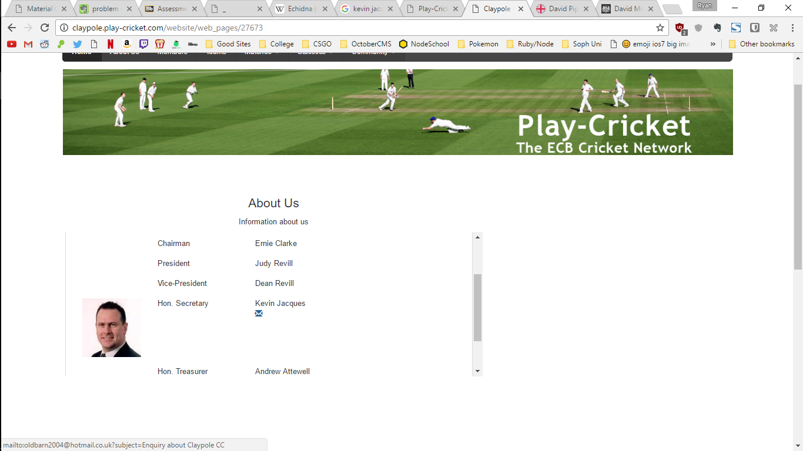
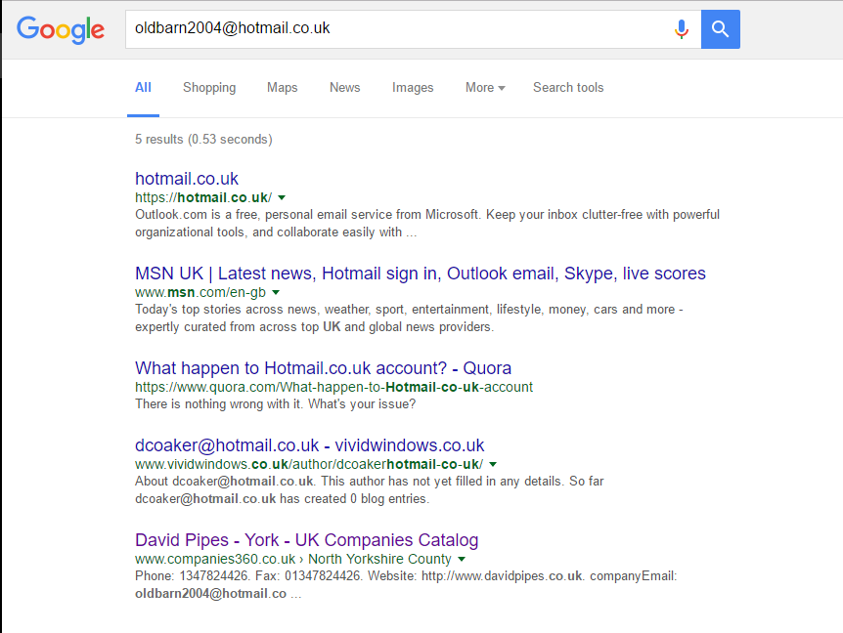
Task One – Finding and Interpreting the code
Clue Three Extended

Slide 7
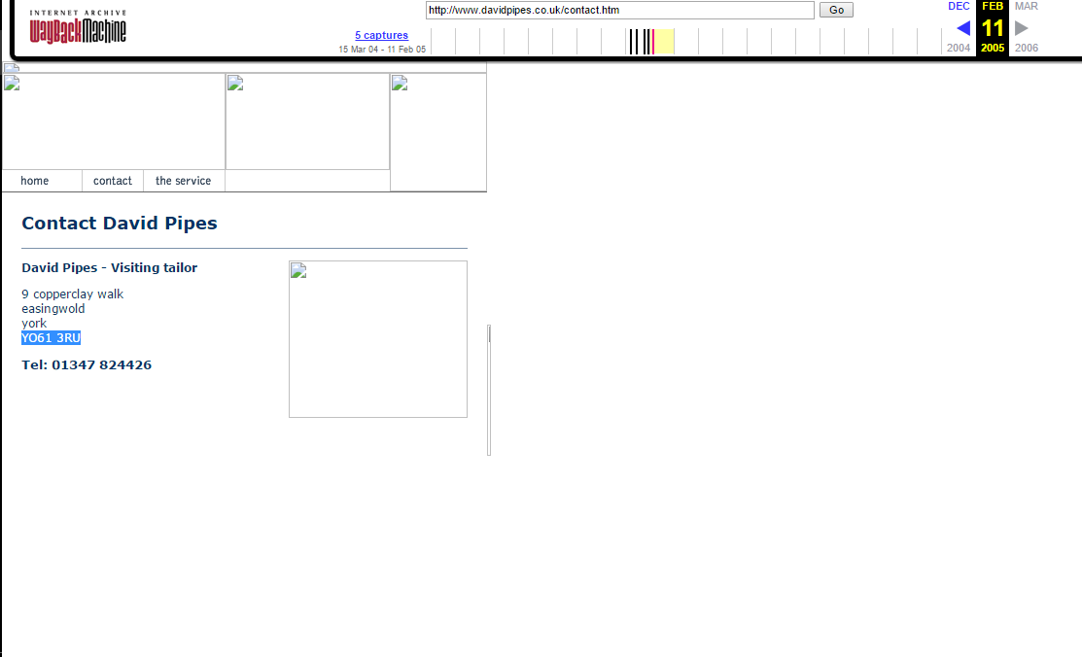

Task One – Finding and Interpreting the code
Clue Three Extended

Slide 8
Task One – Finding and Interpreting the code
Clue Four
INITIAL STATE:
Given clue.
CONSTRUCT
INTERMEDIATE STATE:
Discovered that both men are English film directors
Using online tool to find the exact relation between the two.
Researching who 'Carol Reed' and 'Basil Dearden' are.
CONSTRUCT
INTERMEDIATE STATE:
Discovered that Carrol Reed appears 3 times consecutively, then Basil Dearden and then ‘Charles Crichton’
CONSTRUCT
INTERMEDIATE STATE:
Discovered that both men are BAFTA Award winners for Best British Film
Finding a numeric value for his name.
Exploring the pattern relating them.
CONSTRUCT
GOAL STATE:
The number solution to the formula
16
INTERMEDIATE STATE:
Discovered a value of 156
CONSTRUCT
Calculating 156 mod 35
Notes:
1) assumption made that Carol Reed and Basil Dearden are names of people. Wikipedia pages for both people are found[1] [2].
2) using online tool [3] it is found that there is only one degree of separation between these two Wikipedia pages.
3
[1] https://en.wikipedia.org/wiki/Carol_Reed
[2] https://en.wikipedia.org/wiki/Basil_Dearden
[3] http://degreesofwikipedia.com/
The goal of this problem, like the others, is to find a number which is the solution. Our initial state, given in the clue four is as follows: we are given a sequence of names and prompted to find the next in that sequence. This would then be used to solve a maths problem to give us our solution and reach our goal state. Here is our method to reaching that solution. Each construct is an action we took to reach the next intermediate state.
I believe this to be quite a well defined problem because we are given the order that we must attempt the problem through the formula. We must find the unknown value before we can find the solution through the abstraction of that variable.

Slide 9
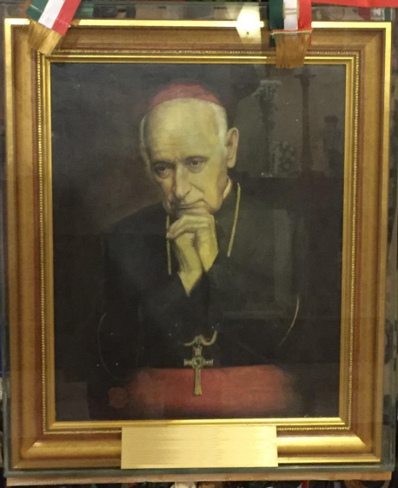

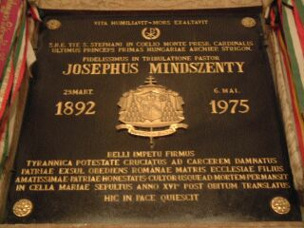
Task One – Finding and Interpreting the code
Clue Five
This is the first clue we started on and got an answer for.
József Mindszenty
Death 6th May 1974
Hungary/Austrian connections
Gravestone shows death in 1975 – irregularity
Exiled from Hungary
Died in Vienna, Austria
Original buried in Mariazelle Etzel
Reburied in Hungary in 1990
1990 – 1975 =15… 15 + 11 = 26
Notes:
This problem seemed to be well defined and easy to follow and is the reason we attempted this clue first. Using our declarative knowledge of Google search tools and our procedural knowledge of using the Google reverse image to get an answer of József Mindszenty. This was then followed by using Wikipedia (En.wikipedia.org, 2016) as a fairly reliable source to find information about his death which occurred on the 6th of May 1974. The problem asked for the Annualised difference between death and his chosen place of rest, which led us first to believe that the grave had been moved or disturbed. Symbols represent a great deal and the hammer and sickle is included as a symbol of communism which he was resistant against (Pike, 2016).
We didn’t want to have confirmation bias though so we used the above citation to continue looking for information and found that a gravestone of Jozsef showed his death in 1975, which was then a more convicting source to us then a Wikipedia article. From the Pike citation we found information about his death and reburial which led us to our answer of 1990. This allowed us to act and apply our solution which is the maths on the slide.
En.wikipedia.org. (2016). József Mindszenty. [online] Available at: https://en.wikipedia.org/wiki/J%C3%B3zsef_Mindszenty [Accessed 7 Dec. 2016].
Pike, J. (2016). Cardinal Mindszenty. [online] Globalsecurity.org. Available at: http://www.globalsecurity.org/military/world/europe/hu-cardinal-mindszenty.htm [Accessed 7 Dec. 2016].

Slide 10
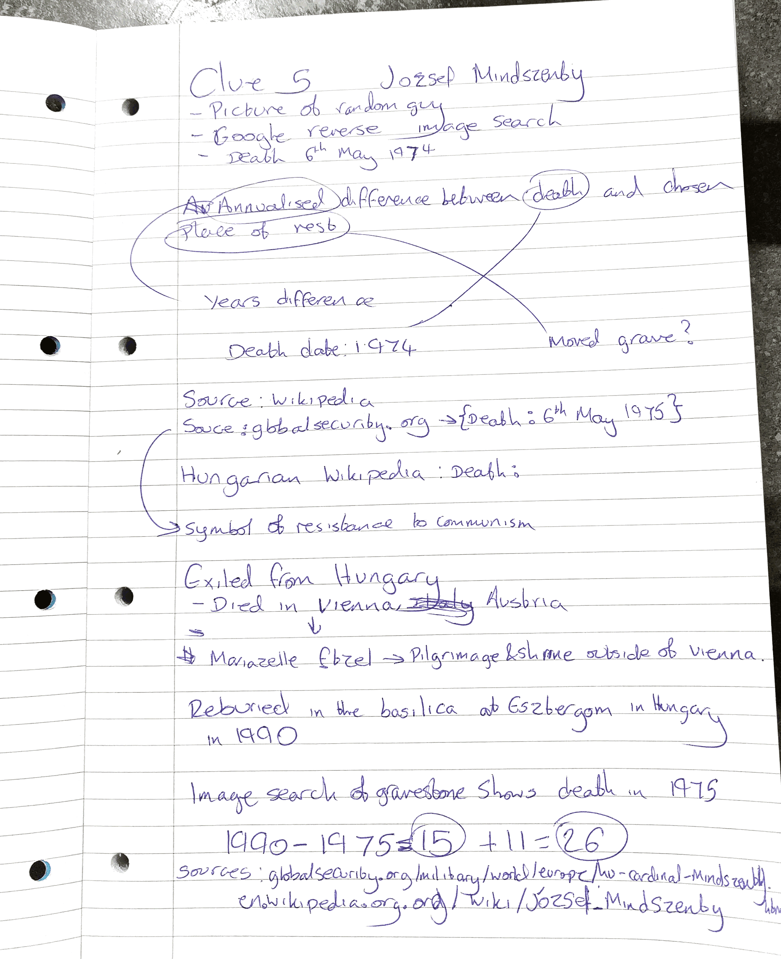

Slide 11
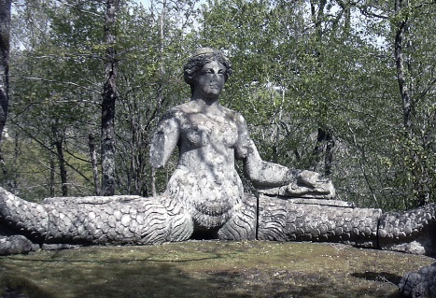
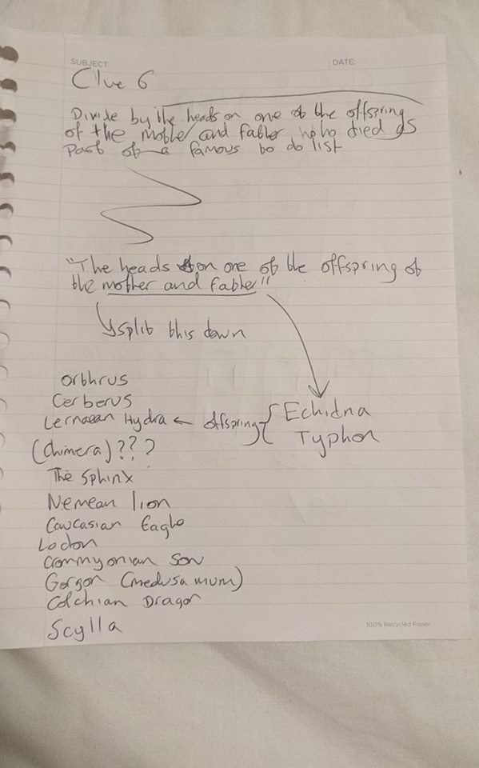
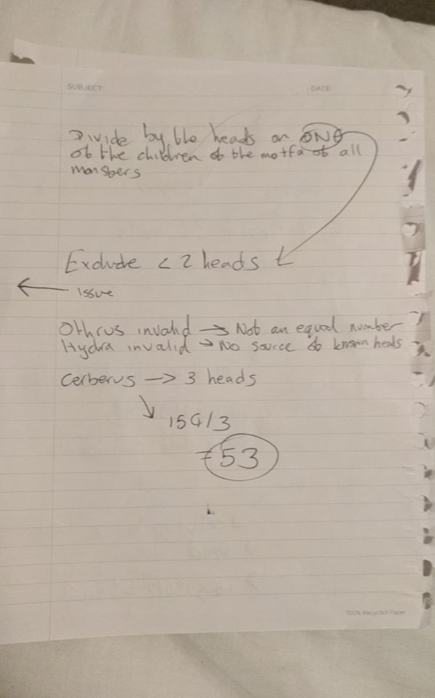
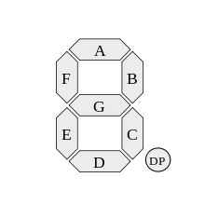
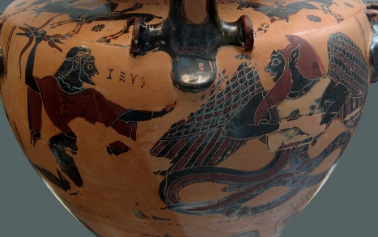
Task One – Finding and Interpreting the code
Clue Six – Divide by the heads on one of the offspring of the mother and father of all gods.
Notes:
This question was well defined (in our opinion) and was clearly linking to Greek mythology. The question was asking at first the heads of one of the offspring of the mother and father of all gods (initial state). These are Echidna and Typhon. In our intermediate state we were able to find a list of the god’s offspring, and then had the task of finding which ones had more than one head, as heads is plural, referring to more than one head. Using heuristic knowledge, aka intelligent guesswork to find that there were only 3 options. Othrus, which gave us an odd number when applied in part two, Hydra which has between, 6, 9, 50 and unknown number of heads which ruled it invalid. To conclude our cognitive process we then checked our answers to see which one was more likely to be valid. And confirmed this between us as our answer
The table given to use becomes easy to understand along side the clue about LEDs. Using procedural knowledge gained through studying A-Level electronics, I am aware of the use of LEDs to display letters, symbols and numbers. Applying this theory to the table, using 1 as the LED on being and 0 being off, where each column represents a segment of the device, we are given a 3 digit number: 159

Slide 12
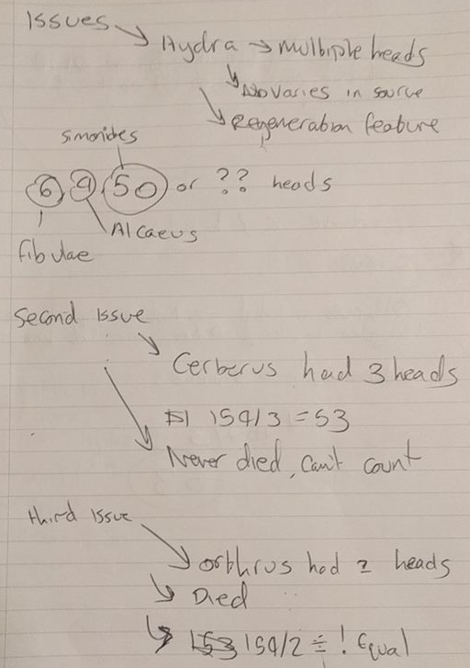
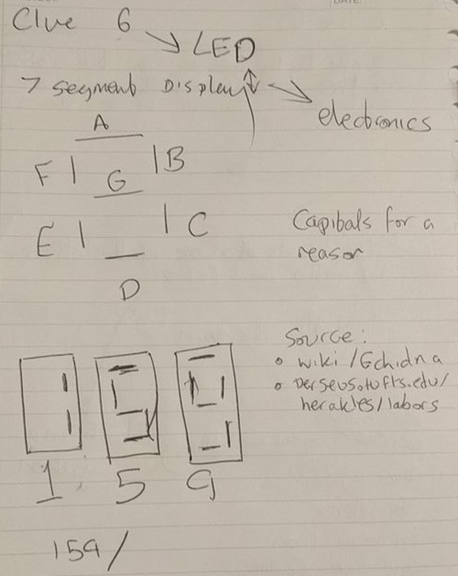
Task One – Finding and Interpreting the code
Clue Six

Slide 13
Task One – Stage 2 Interpreting the code
Interpreting the code
Clue 1 | Clue 2 | Clue 3 | Clue 4 | Clue 5 | Clue 6
15 | 52 | 43 | 16 | 27 | 53
0 | 1 | 2 | 3 | 4 | 5 | 6 | 7 | 8 | 9 | 10 | 11
1 | 5 | 5 | 2 | 4 | 3 | 1 | 6 | 2 | 7 | 5 | 3
OR
1 | 2 | 3 | 4 | 5 | 6 | 7 | 8 | 9 | 10 | 11 | 12
1 | 5 | 5 | 2 | 7 | 4 | 2 | 6 | 3 | 1 | 5 | 3

Slide 14




Task One – Stage 2 Interpreting the code
Interpreting the code
1 | 2 | 3 | 4 | 5 | 6 | 7 | 8 | 9 | 10 | 11 | 12
1 | 5 | 5 | 2 | 4 | 3 | 1 | 6 | 2 | 7 | 5 | 3
 |  |  |  | 3 | 4
 |  |  |  | 2 |  |  |  | 3
 |  |  |  |  |  | 7 |  |  | 1
 |  |  |  | 7 |  | 2
1 | 5 | 5 | 2 | 7 | 4 | 2 | 6 | 3 | 1 | 5 | 3
$$f(5,6)$$
$$f(5,9)$$
$$f(7,10)$$
$$f(5,7)$$
Notes:
This stage followed a whole cognitive process for us, where we understood that the problem is that the code needs solving, and that the problem is that we need to solve it in order to present this information to you. We applied some heuristic knowledge trying to find links between general information and the code. We first used this knowledge to apply each number to a first Monday of the month, however this doesn’t apply to 2016, nor 2017, but due to each number being a possible date we were confident (which could’ve been a confirmation bias) that it was a date of some sort. We chunked the question into smaller parts to decide and act. Each day was either a Friday or Saturday which could imply that each number is the first date she has off that month, expect Monday where there will be an exception because it’s her birthday and she is visiting her parents instead.

Slide 15
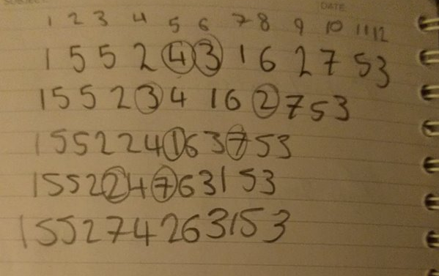
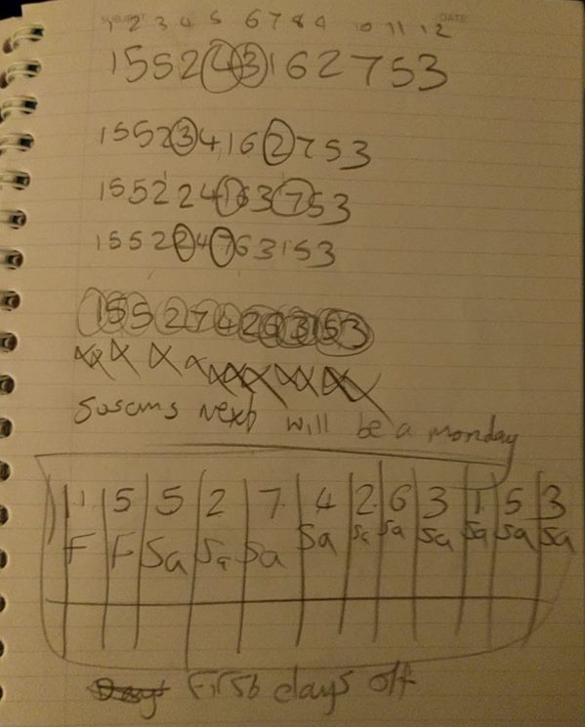
Notes:
This leads us to the conclusion you wish to know when our next birthday is. Mine is a Friday, so it Kat’s, and Michaels is a Tuesday.

